Slide 1




sarawak Matriculation College
DISCORD
STEP-BY-STEP
SANDRAN ABDULLAH & SHAFIQ RASULAN

Slide 2

TABLE OF CONTENT
01. Registration
02. Joining a Discord Server
03. Creating a Discord Server
04. Creating Categories
05. Creating Voice/Text Channels
06. Setting Roles
07. Roles Management
08. Bots

Slide 3

PART 1
01. Registration

Slide 4


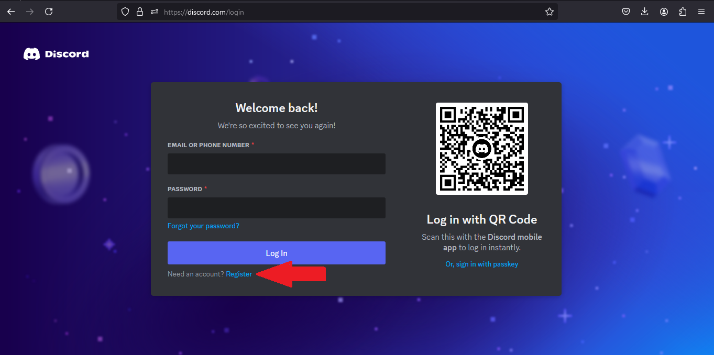

registration
Step 1: Got to Discord.com
Step 2:
Click on Register

Slide 5
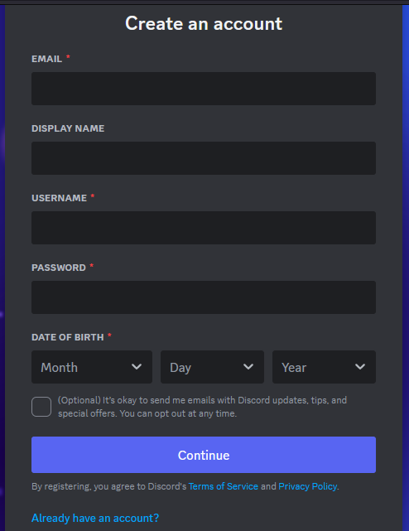
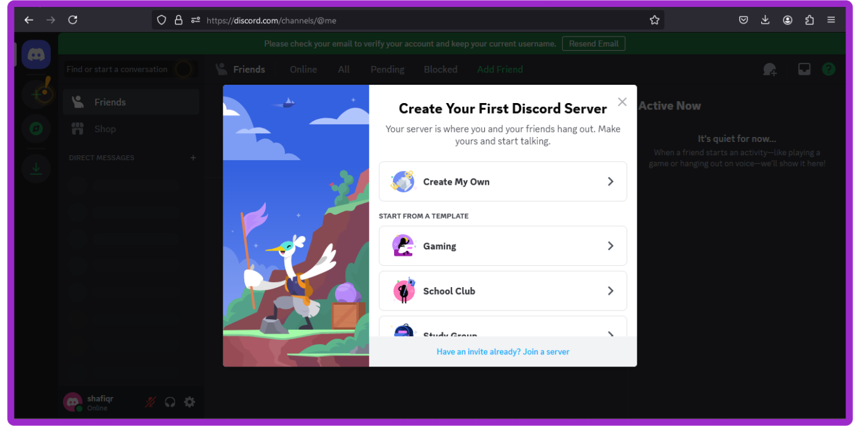
registration
Step 3:
Fill in the form and click “Continue”
Step 3:
You are ready when the screen shows this!

Slide 6

PART 2
02. Join a discord server

Slide 7
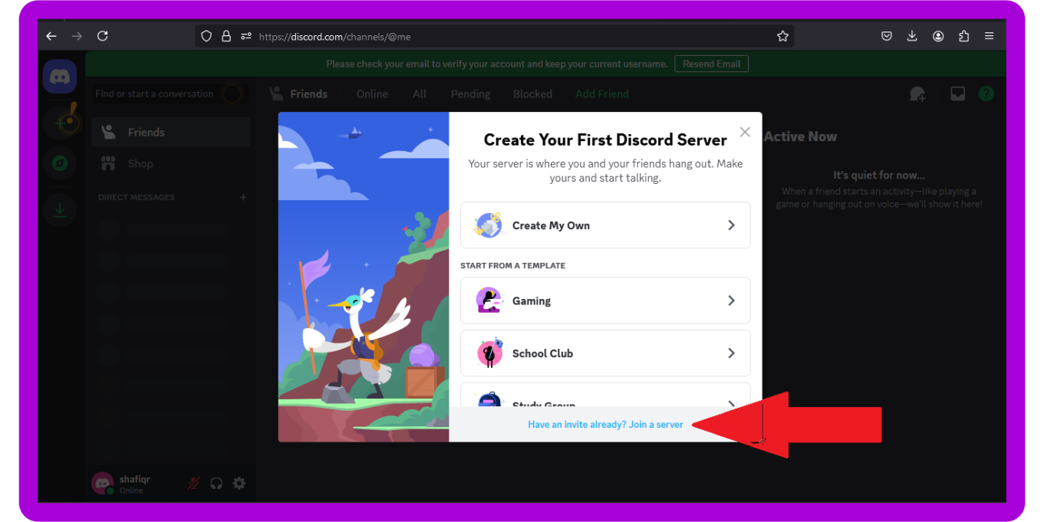
joining a server
Step 1: Make sure you have your invitation link.
Step 2: Click on
“Join a server”

Slide 8
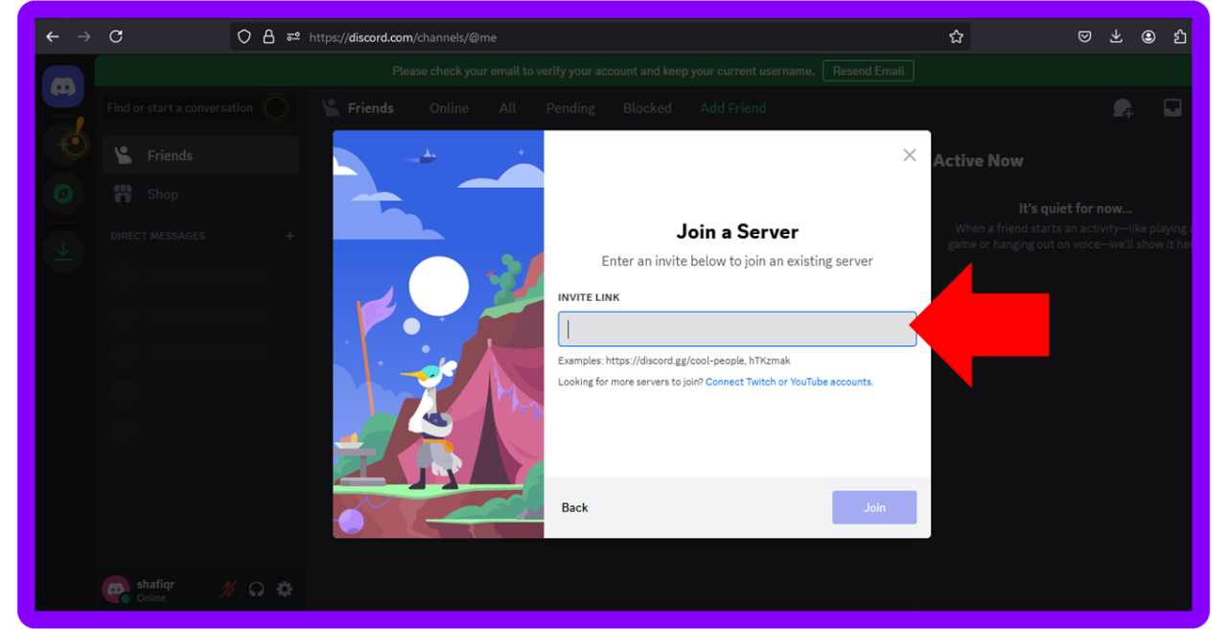
joining a server
Step 3: Paste the link in the box given
Step 4:
Click “Join”

Slide 9


PART 3
03.
a discord server

Slide 10
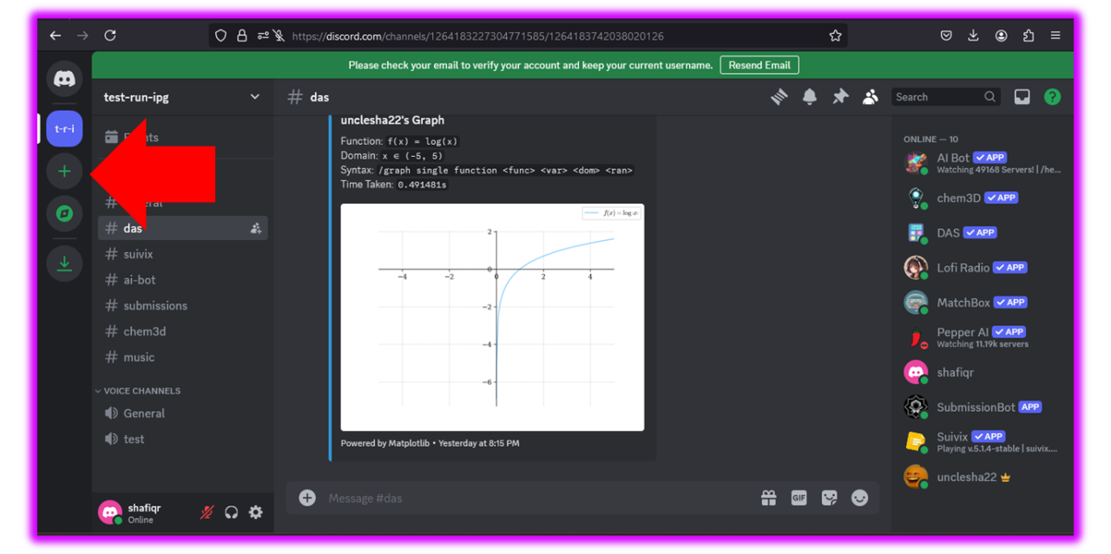
Create a server
Step 1: Click on
“Add a server”

Slide 11
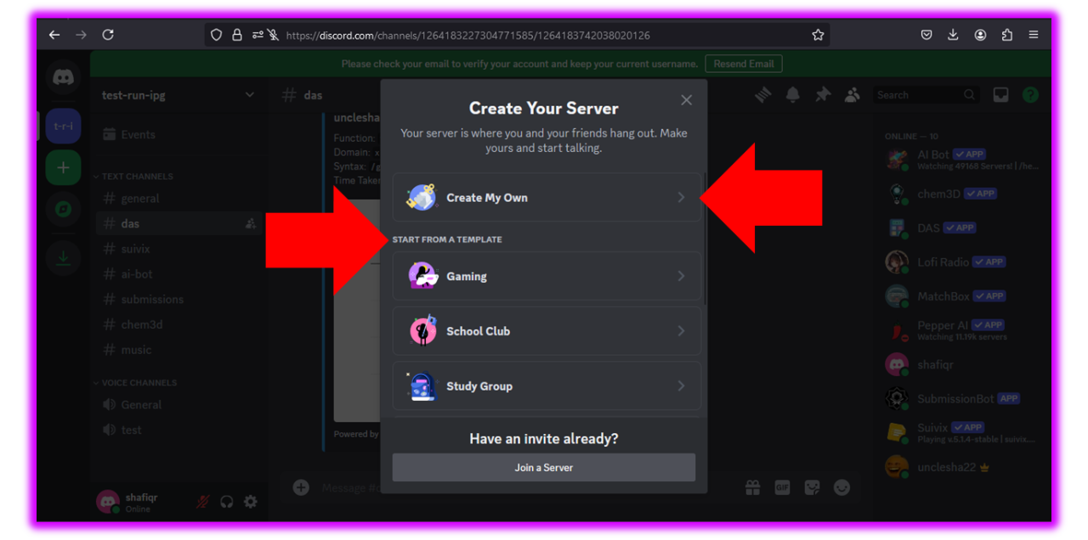
Create a server
Step 2:
Choose between creating your own server or use a template

Slide 12
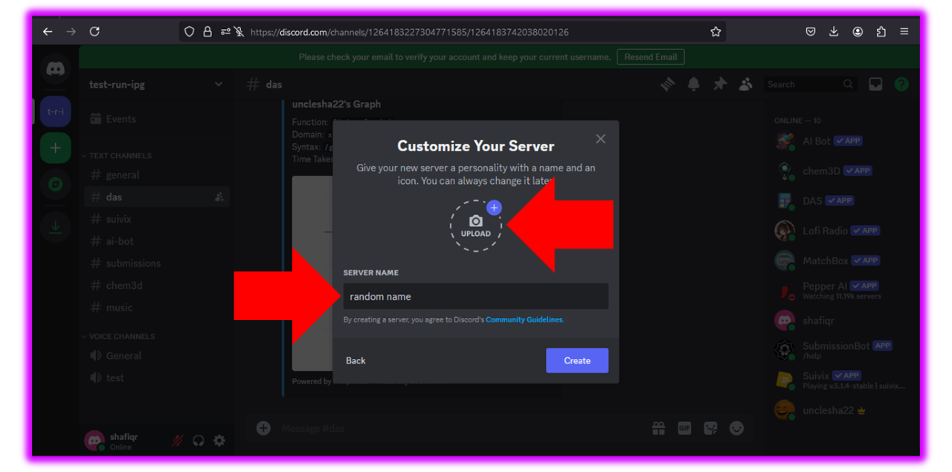
Create a server
Step 3:
Now you can upload server logo/picture & name your server

Slide 13
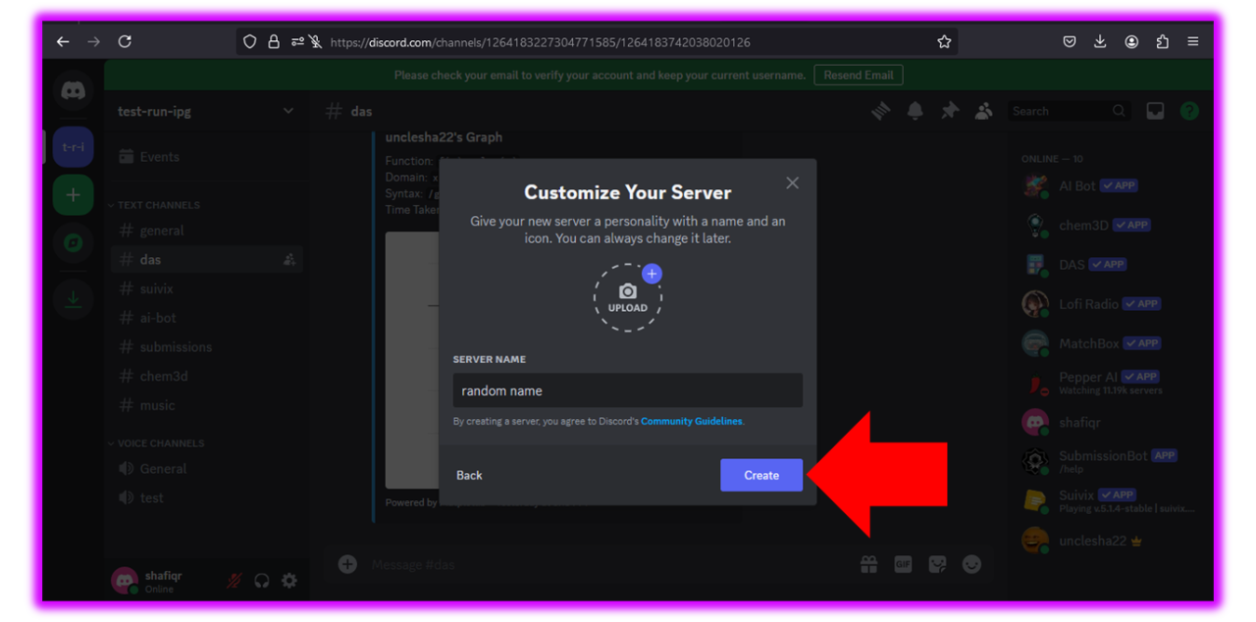
Create a server
Step 4:
Click Create!

Slide 14

PART 4
04. Create Categories

Slide 15
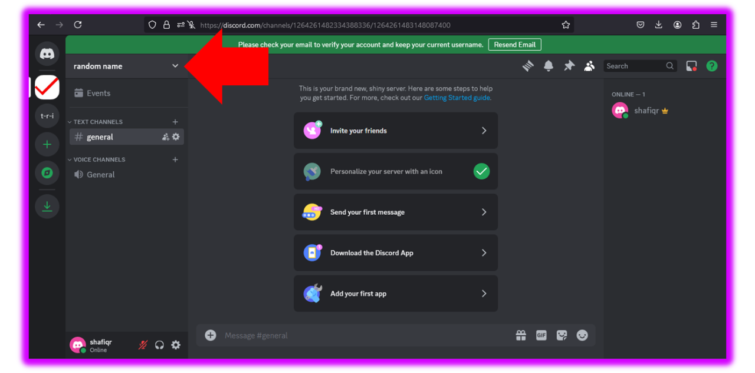
Create categories
Step 1: Click on the drop down menu

Slide 16
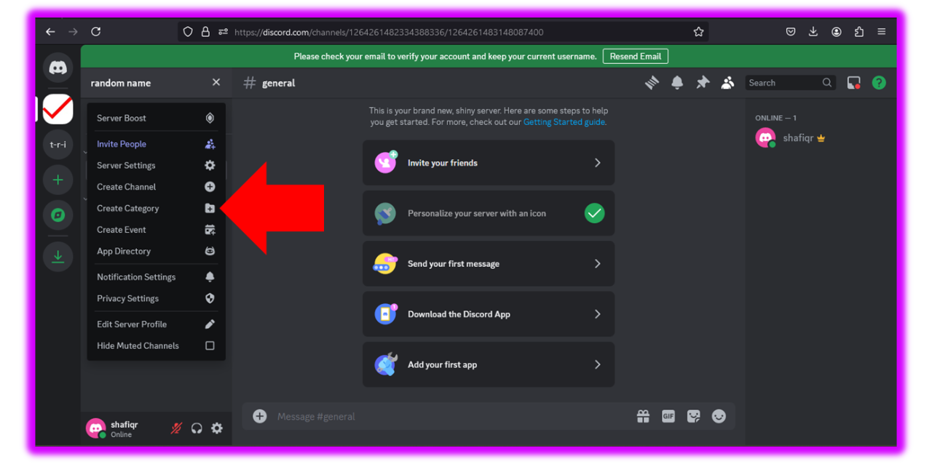
Create categories
Step 2: Click on
“Creat Category”

Slide 17
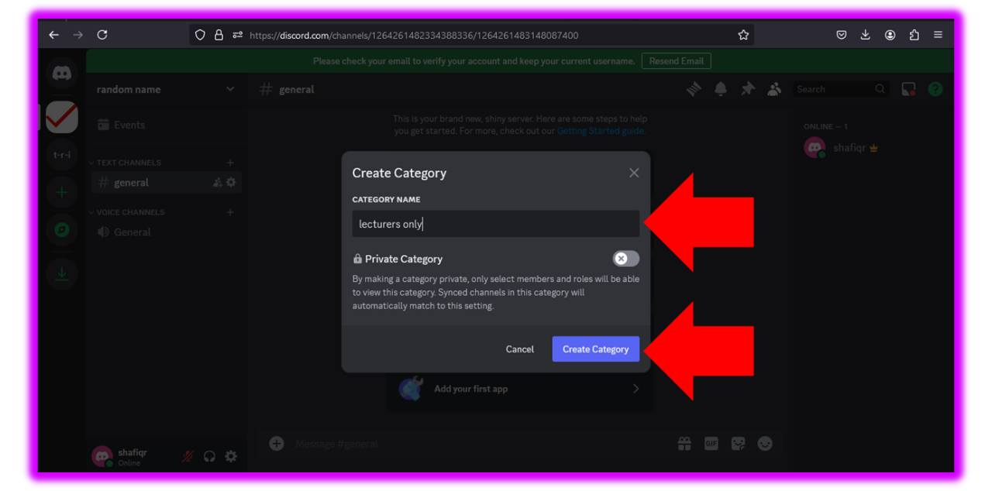
Create categories
Step 3:
Name your category and click “Create Category”

Slide 18
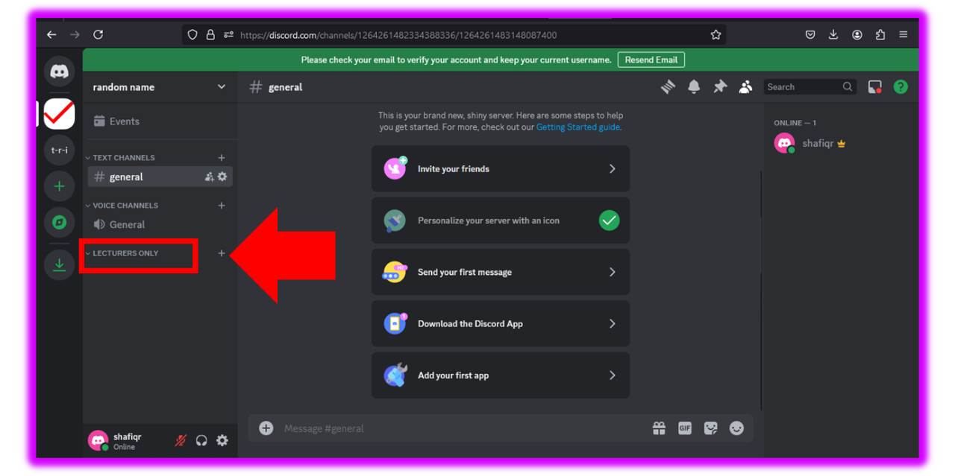
Create categories
Step 4:
Category has been created

Slide 19

PART 5
05. Create Voice/Text Channel

Slide 20
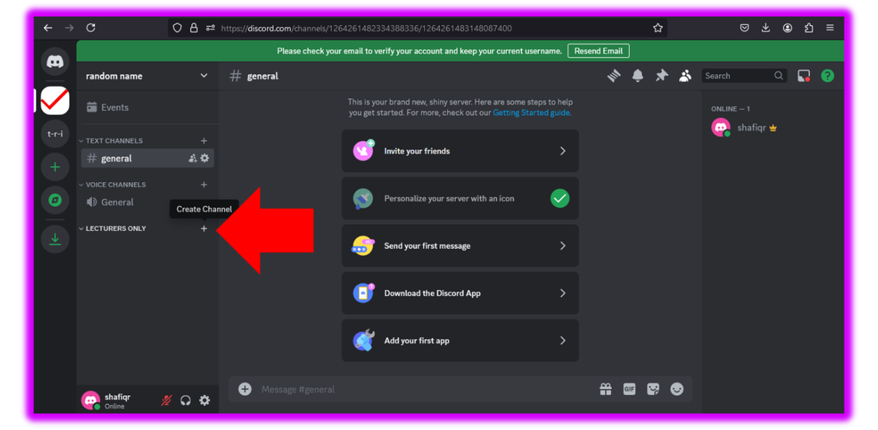
Text/Voice Channel
Step 1:
Click on “+” button next to your chosen category

Slide 21
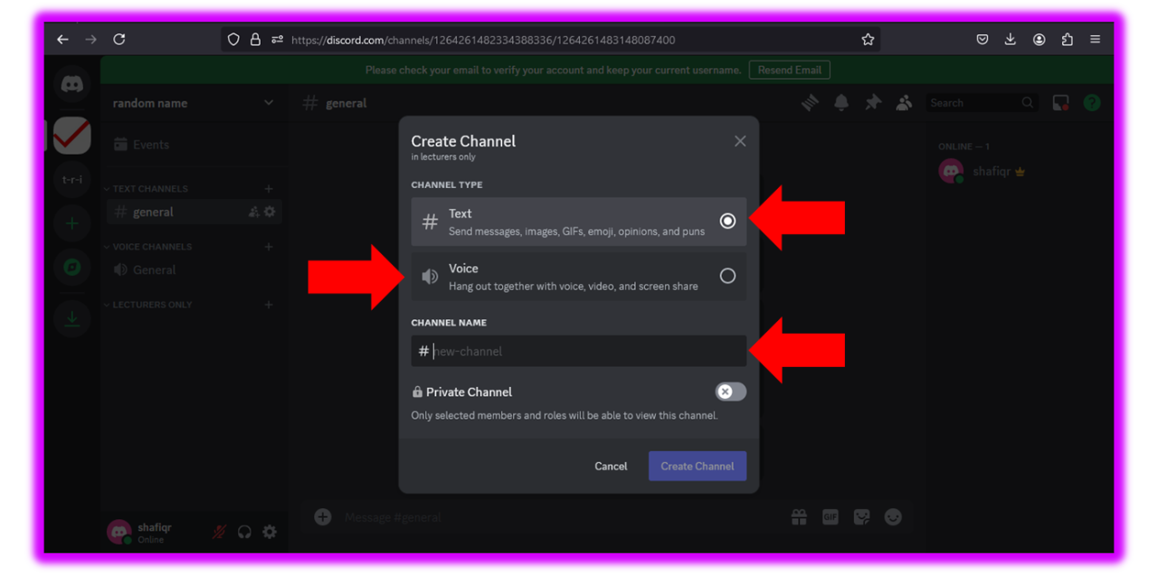
Text/Voice Channel
Step 2:
Choose between text channel or voice channel and then name your text/voice channel

Slide 22
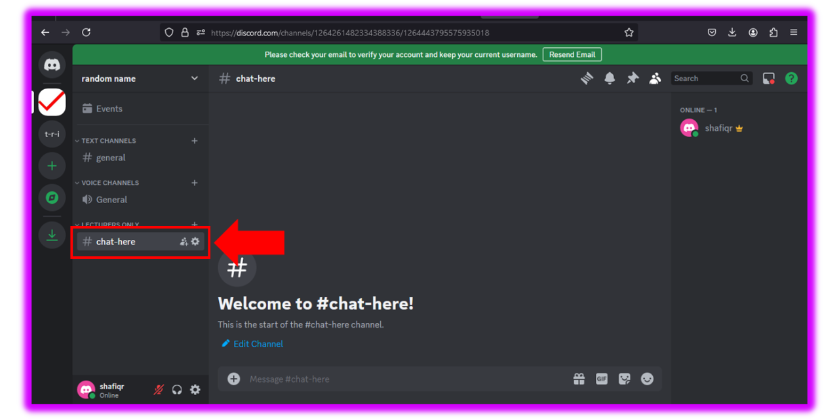
Text/Voice Channel
Step 3: Created channel will appear under the category.

Slide 23

PART 6
06. Create Roles & Managing them

Slide 24
Roles
Step 1: Click on the drop down menu

Slide 25
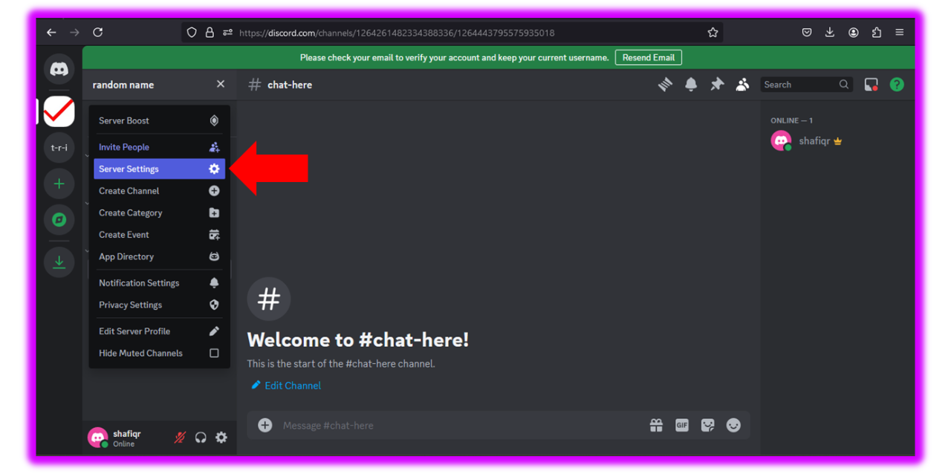
Roles
Step 2: Choose
“Server Settings”

Slide 26
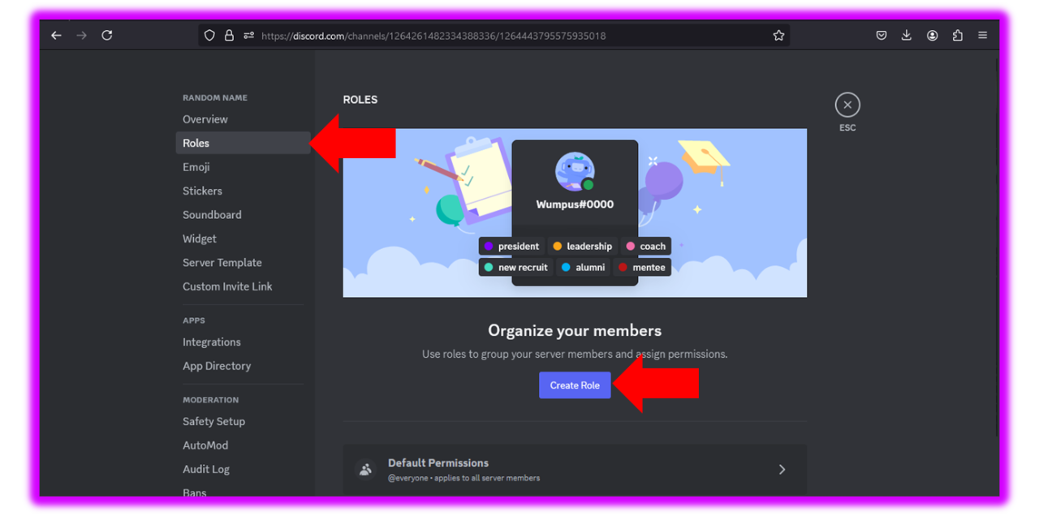
Roles
Step 3: Choose Roles then click on “Create Roles

Slide 27
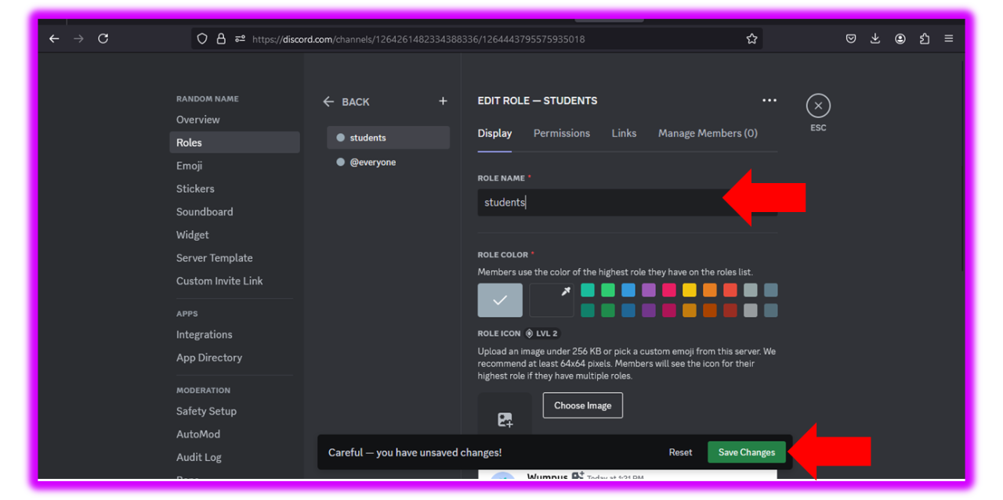
Roles
Step 4: Name the role and click “save changes”

Slide 28
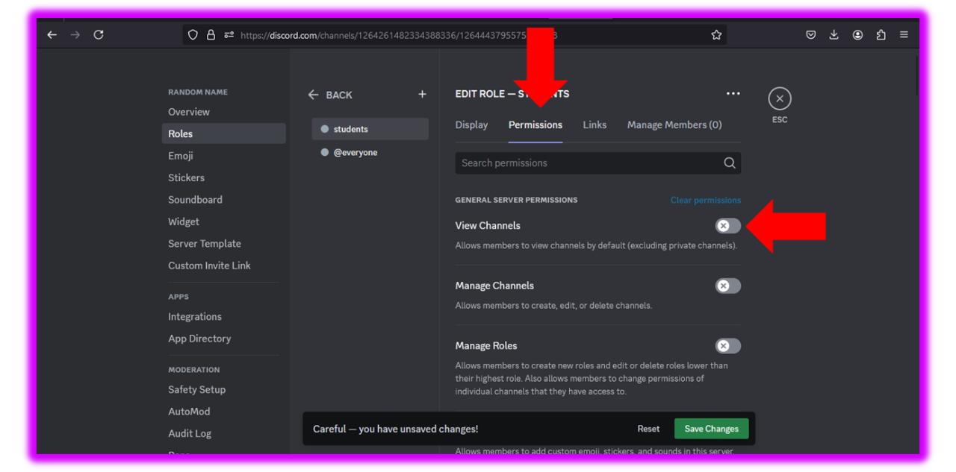
Roles
Step 5: Default permissions can be set by clicking “Permissions”

Slide 29
PART 7
07. Role management

Slide 30
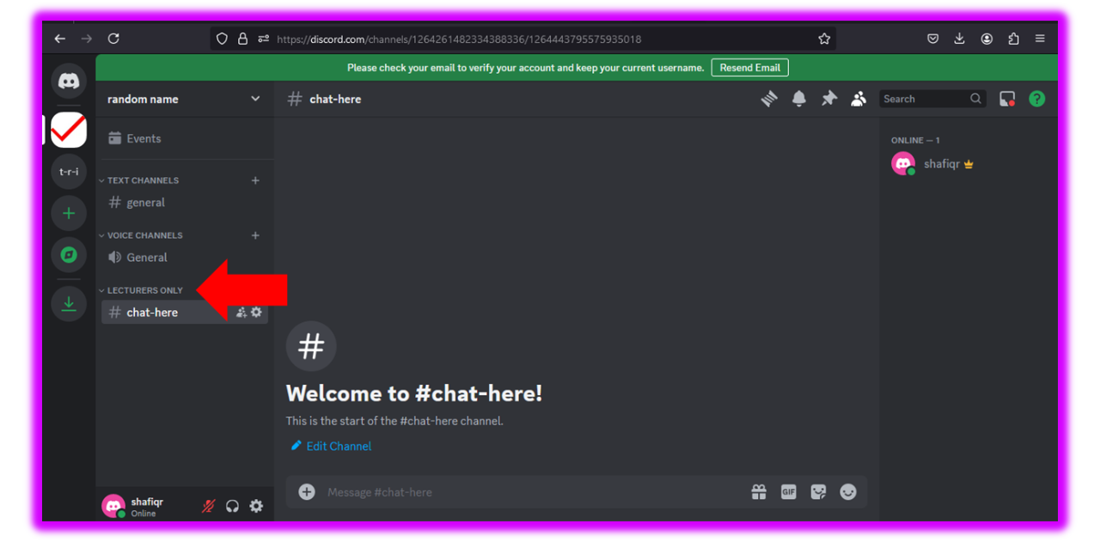
Roles
Step 1: Right click on the chosen category

Slide 31
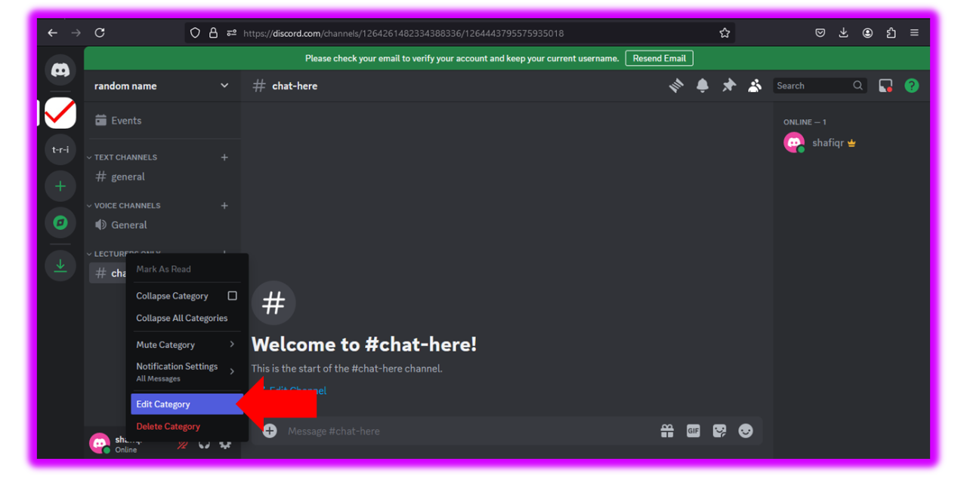
Roles
Step 2: Head to “Edit Category”

Slide 32
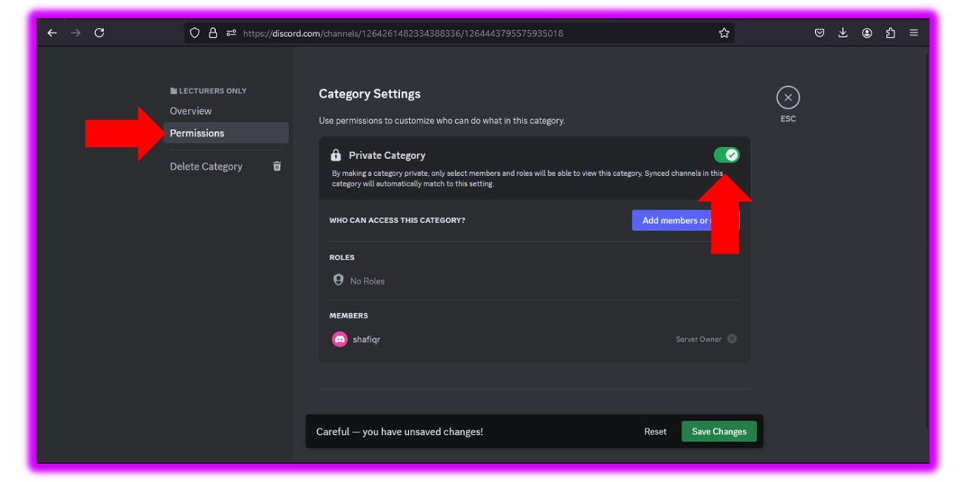
Roles
Step 3: Click on permissions then set private to tick

Slide 33
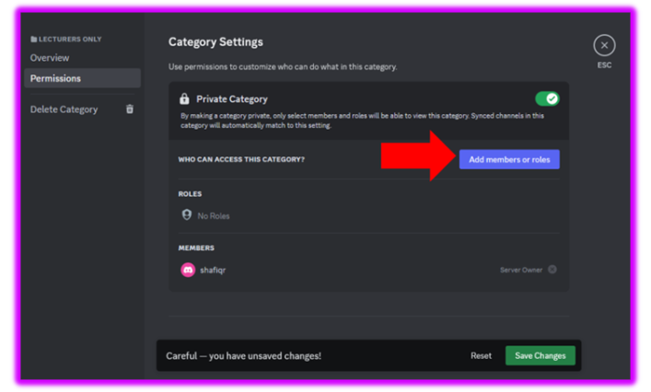
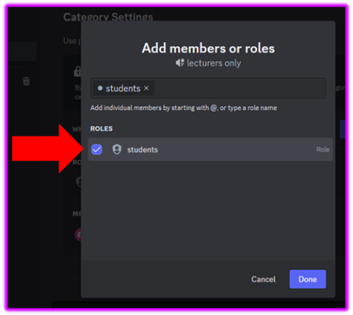
Roles
Step 4: Choose roles to set their permissions

Slide 34
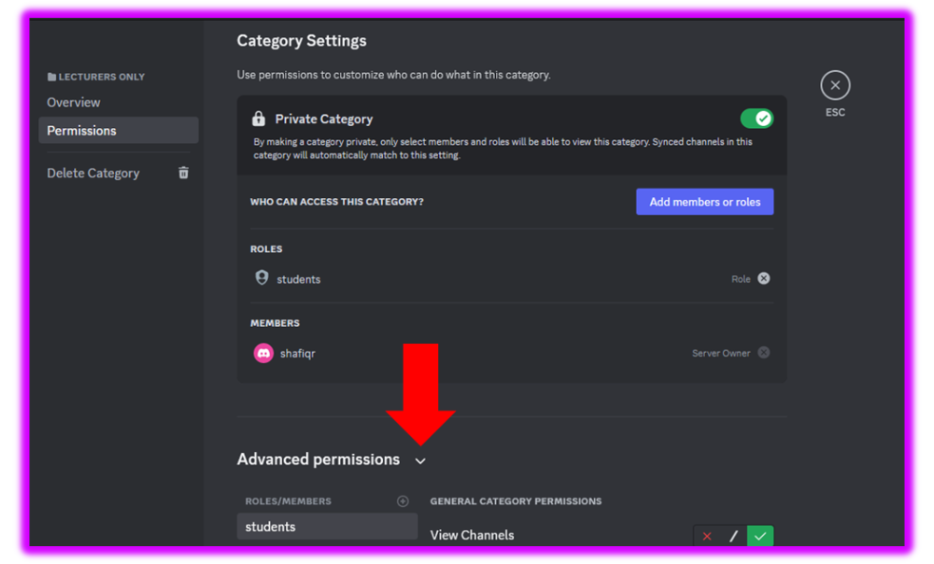
Roles
Step 5: Click on the drop down menu next to “Advanced permissions”

Slide 35
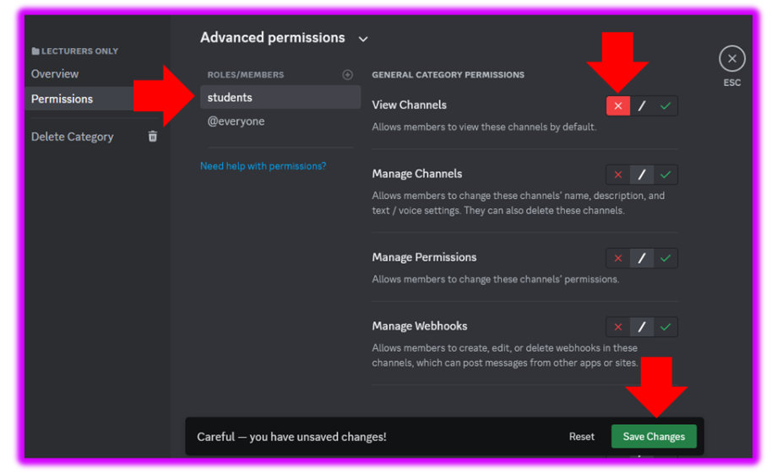
Roles
Step 6: Choose the role, choose their permissions and save changes.

Slide 36

Roles
Let’s check if it’s hidden from students

Slide 37

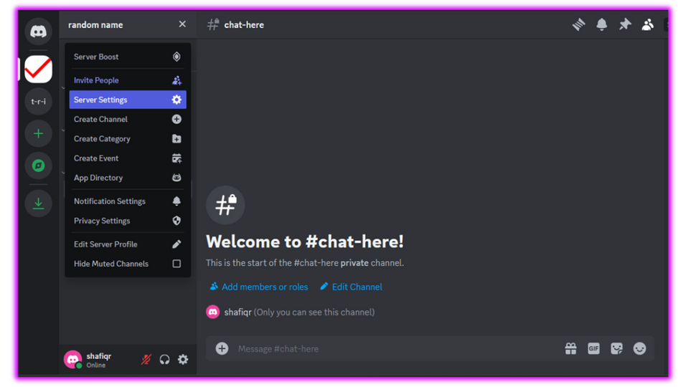

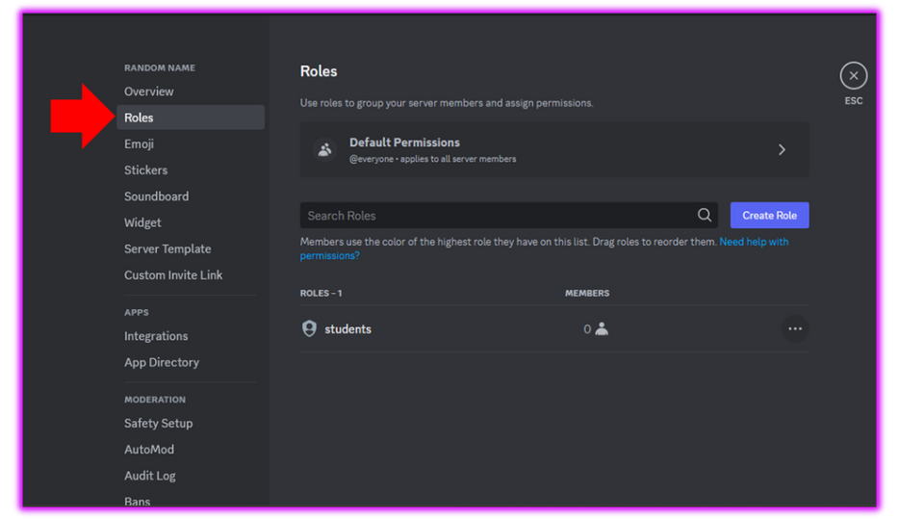
Roles

Slide 38

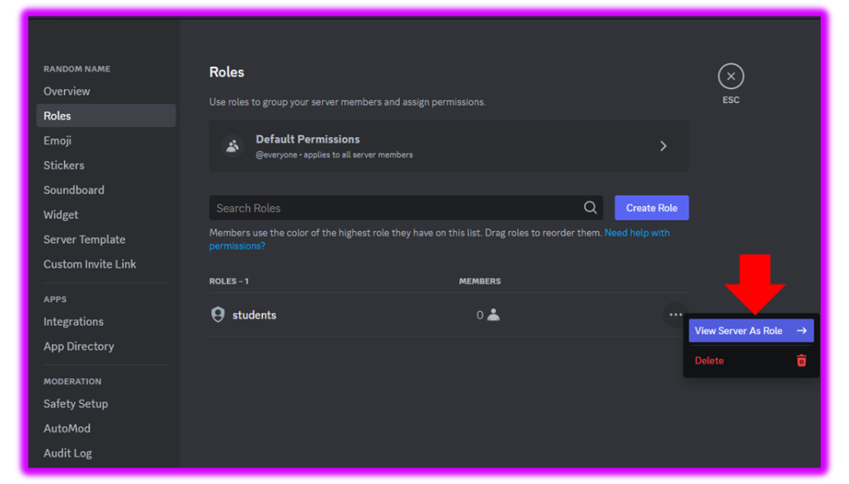
Roles

Slide 39
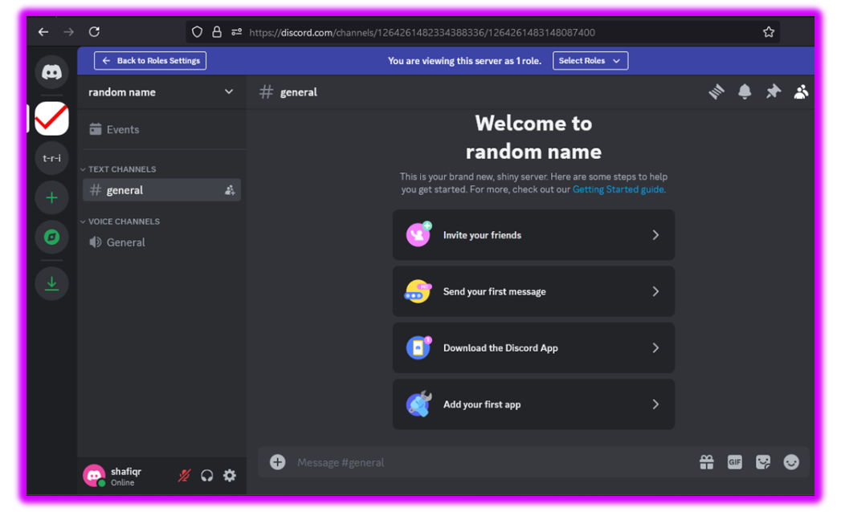

Roles
What the student sees
“Lecturer Only” Category is hidden

Slide 40


PART 8
08. Bots

Slide 41

Bots
Let’s try using Suivix Bot

Slide 42
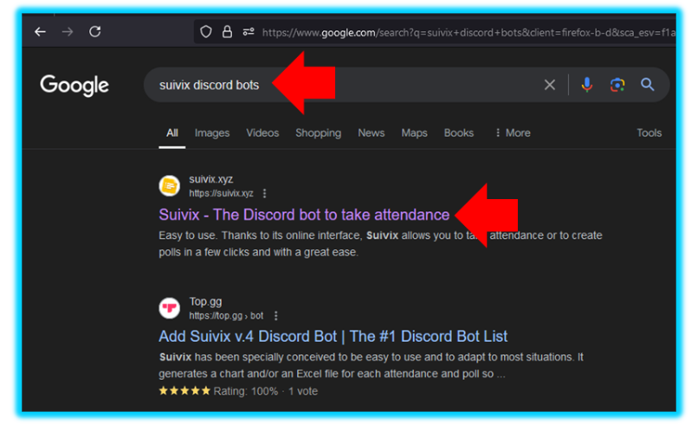



Bots
Google “Suivix Discord Bot”
Click on first link

Slide 43
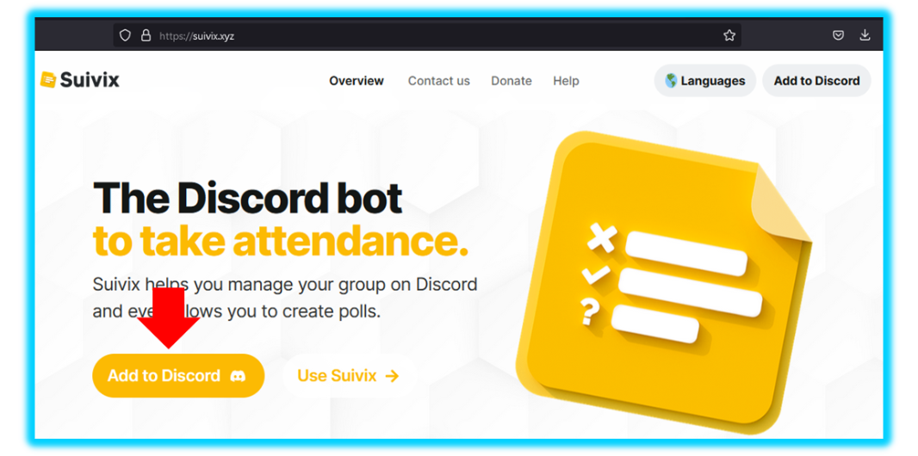

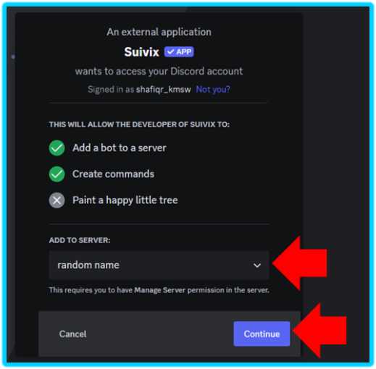

Bots
Click “Add to Discord”
Choose Server and click Continue

Slide 44
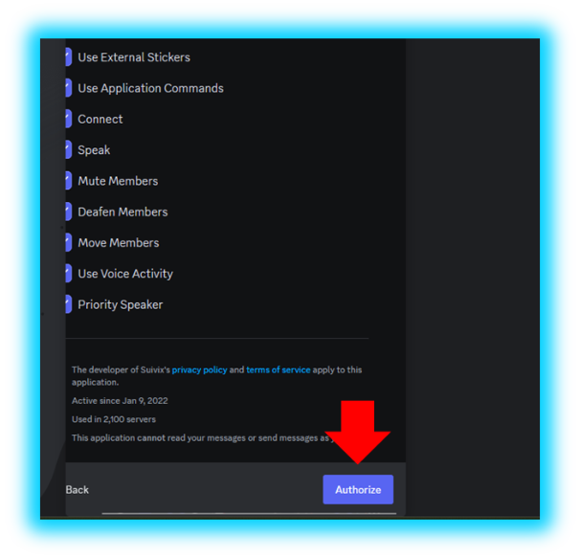

Bots
Click Authorize

Slide 45
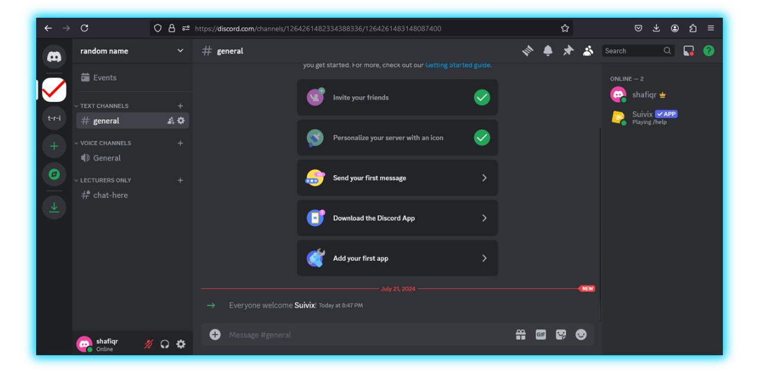

Bots
Bot Added!

Slide 46
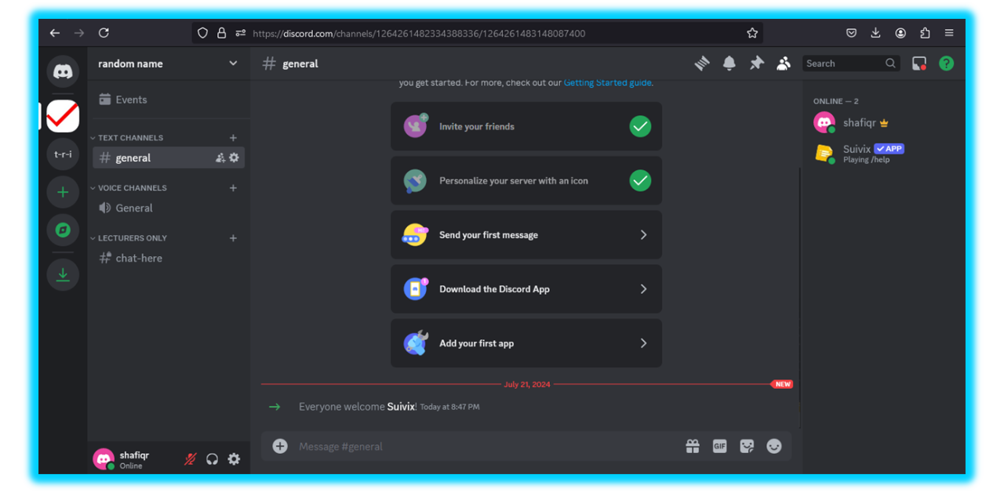
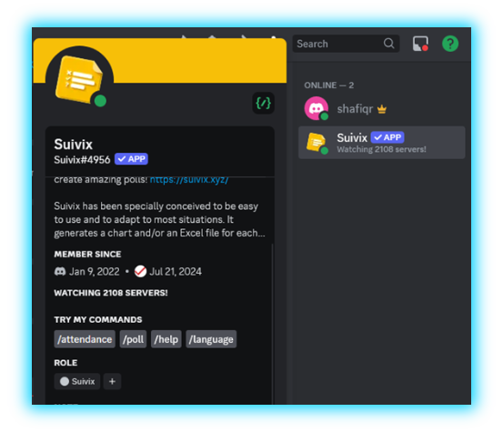

Bots
Click on this and it’ll show you its commands!

Slide 47

Bots
But how do I use Suivix?

Slide 48

Bots
Enter Voice Channel
Type out suivix command in any text channel that suivix is in
Choose “Take attendance directly on Discord”
Choose correct voice channel and role

Slide 49

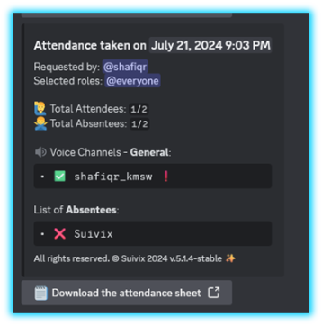
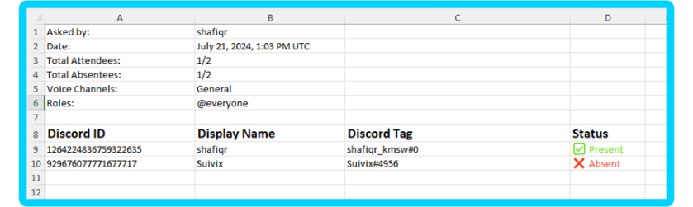
Bots
Results!
Downloading the attendance sheet gives attendance list in .xlsx file

Slide 50


Bots
Another Example Bot?
Let’s Try
Discord
Algebra
System (DAS)

Slide 51
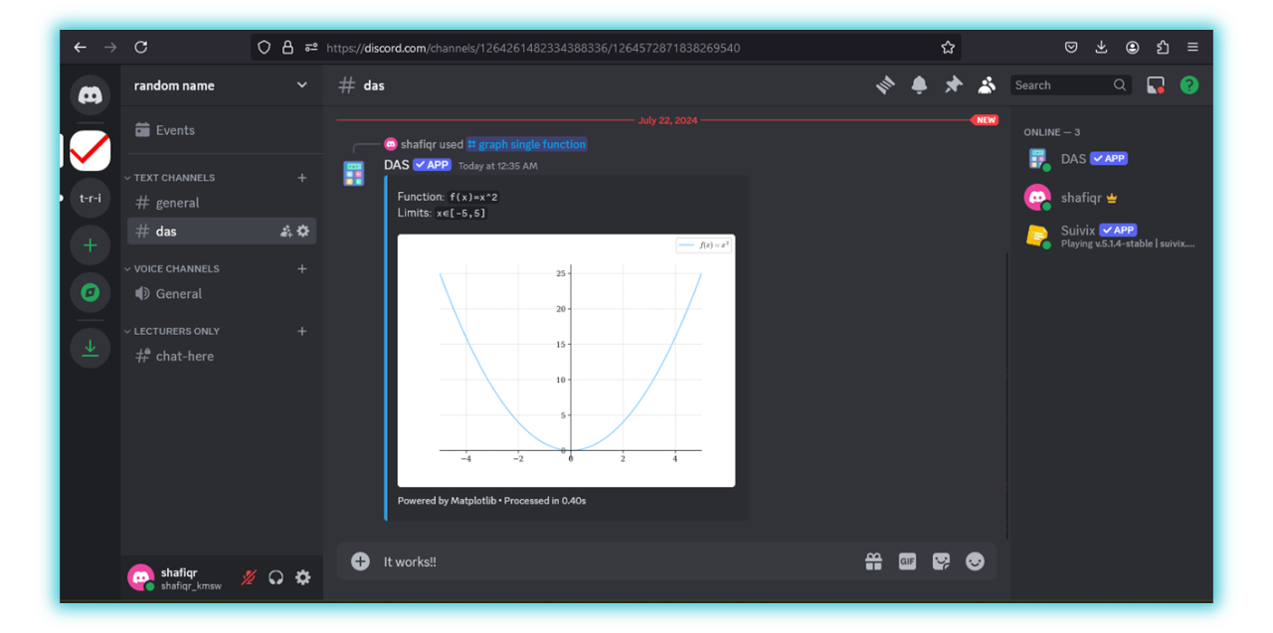
Bots
Results!
Click here to see how I did it!

Slide 52


sarawak Matriculation College
TALK TO US
sandran@kmsw.matrik.edu.my - Sandran Abdullah
shafiq@kmsw.matrik.edu.my -Shafiq Rasulan

